Slide 1


Predicting stratification based on borehole and CPT data using machine learning and improved 3D coupled Markov chain
Tongji Group
Presenter: Jinzhang Zhang
Arlington, Virginia, USA, July 23–26, 2023
Notes:
Dear online and offline friends
I’m Jinzhang Zhang, from Tongji University.
It is our great honour to be awarded the 1st prize in this competition.
First, I’d like to thank the organizer of the TC304 309 Student Contest committee for providing this opportunity to introduce our work online.
The topic of this presentation is: Predicting stratification based on borehole and CPT data using machine learning and improved 3D coupled Markov chain.

Slide 2







Acknowledgements:
Supervisors
Hongwei Huang
Dongming Zhang
Tongji University
Tongji University
Group
members
Jinzhang Zhang
Qihao Jiang
Yelu Zhou
Lei Fu
Hao Bai
2
Notes:
First, thanks for Prof. Hongwei Huang and Prof. Dongming Zhang for their supervision and help during the process of this competition.
Then, I’ll introduce our team members. Dr. Qihao Jiang, Yelu Zhou, Fu Lei and Bai Hao. Thanks for their contribution.

Slide 3

Content
1
Background
2
Problem statement and proposed framework
3
ML-based soil types classification using CPT data
4
Geologic uncertainty simulation using improved CMC
5
Uncertainty quantification of results
6
Conclusion
Notes:
Next, I’ll introduce our work from 6 parts.

Slide 4
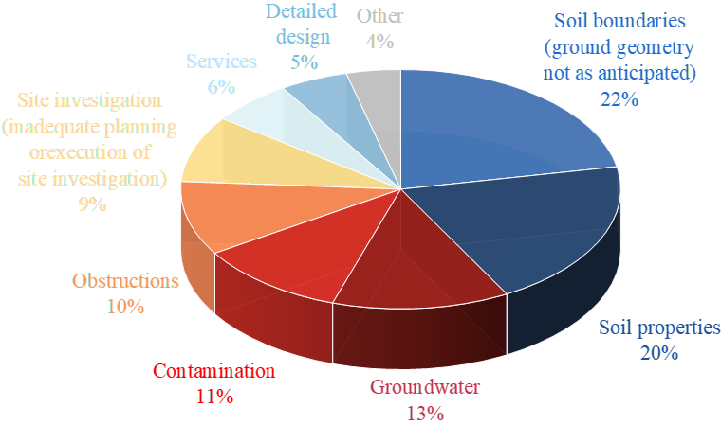
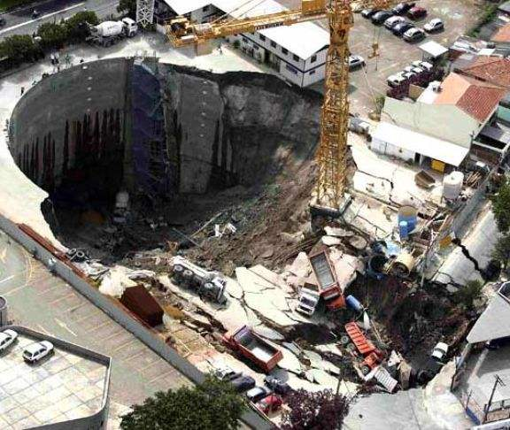
1. Background
1 Background
Geological Uncertainty in Engineering
Accident
Expected
22%
Actual
Types of ground-related problems encountered during construction (Clayton, 2001)
Collapse in Sao Paulo, Brazil（2007）
7 people death，tunnel shutdown for 2 years
Geological Uncertainty is main cause of underground construction risk.
Notes:
First is the background. As we all known, Geological Uncertainty is the main cause of underground construction risk.

Slide 5
Content
1
Background
2
Problem statement and proposed framework
3
ML-based soil types classification using CPT data
4
Geologic uncertainty simulation using improved CMC
5
Uncertainty quantification of results
6
Conclusion
Notes:
Then is the problem statement

Slide 6
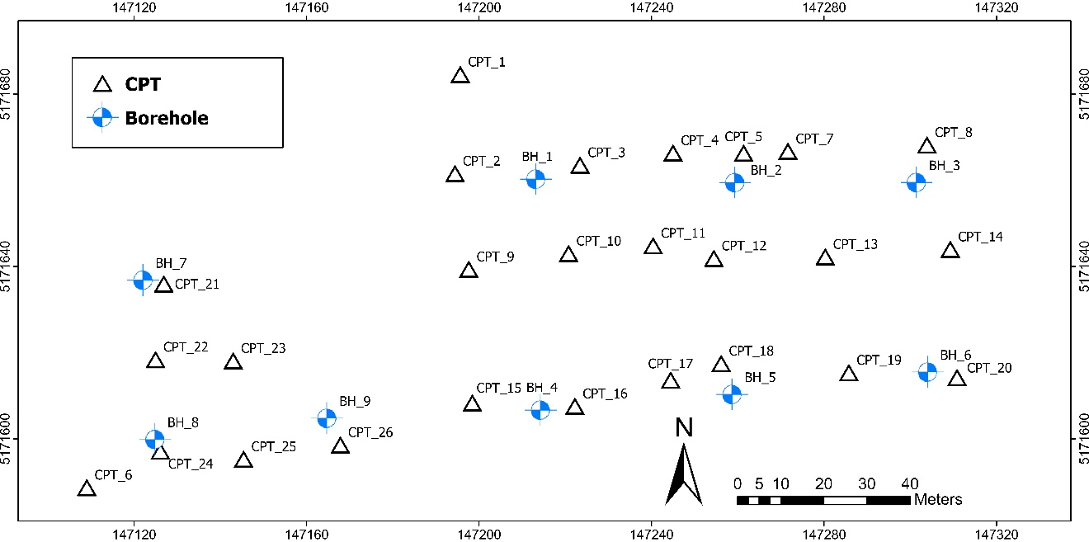
1. Background
2 Problem statement and proposed framework
Dataset description
Data: provides 26 CPT soundings and 5 boreholes (2,4,6,7,8)
Aim: predict soil stratification at 4 reserved boreholes (BH1,3,5,9)
Notes:
It provides 26 CPT soundings and 5 boreholes
The Aim of this study is to predict soil stratification at 4 reserved boreholes.

Slide 7
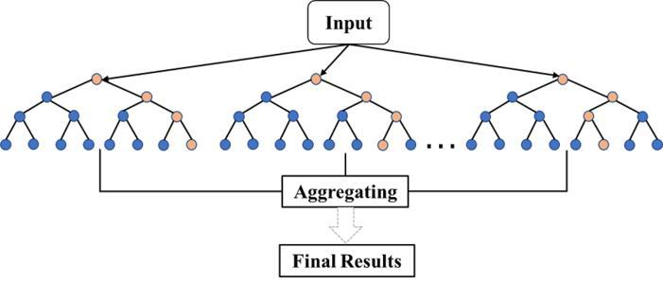
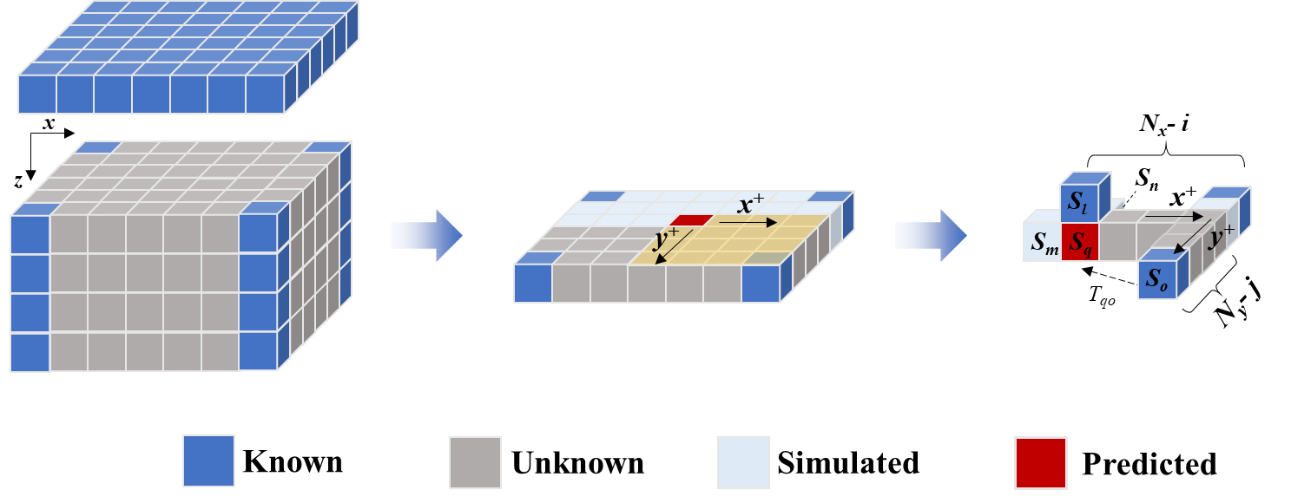
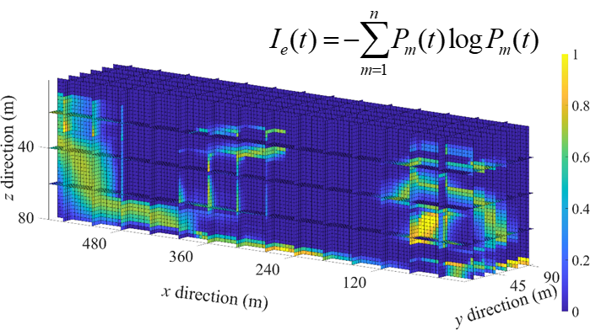
1. Background
2 Problem statement and proposed framework
Proposed framework in this competition
Merge soil types from borehole
Use ML to classify CPT soil types
GW | GP | GM | ML | OL | Pt | SW | SP | SM
G |  |  | L |  | Pt | SC |  | SM
1
2
Classify
Random Forest
More rational and easy clustering
1
2
3
4
3
4
Uncertainty quantification
Reconstructing stratigraphy
3D entropy-based modeling
Match predictions with test boreholes
Data
Element
MSE
ICMC3D
Notes:
Next is the proposed framework.
Step1: We reclassify soil types.
Step 2: Because we only have 5 borehole data. So we need to expand our dataset using the CPT data.
Step 3: Predicted soil stratification.
Step 4: Using the proposed uncertainty quantification index to evaluate the accuracy of results.

Slide 8
Content
1
Background
2
Problem statement and proposed framework
3
ML-based soil types classification using CPT data
4
Geologic uncertainty simulation using improved CMC
5
Uncertainty quantification of results
6
Conclusion
Notes:
Next section is the machine learning-based soil types classification using CPT data .

Slide 9
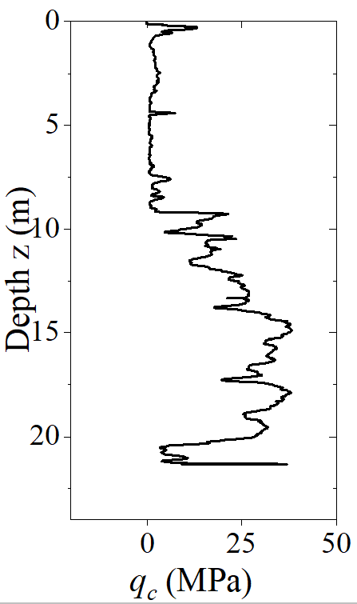
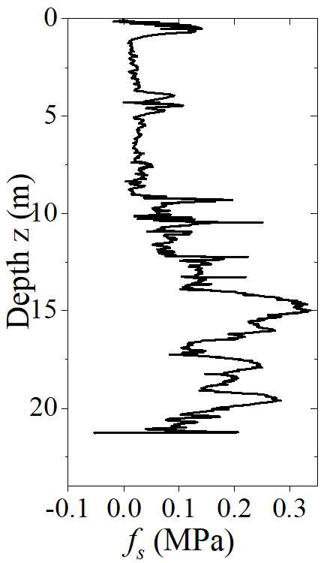
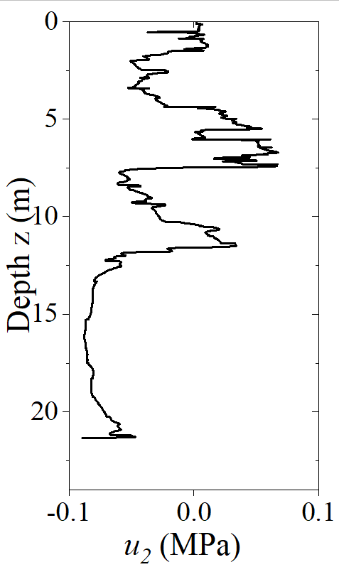
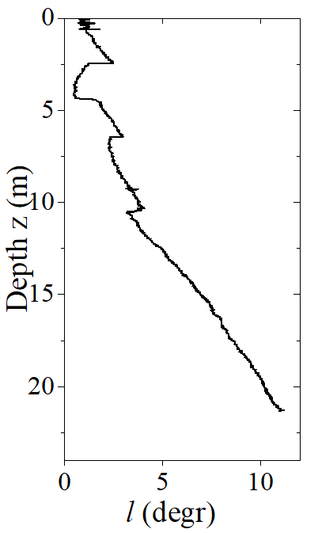
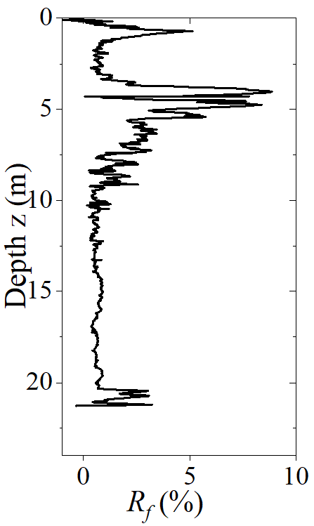
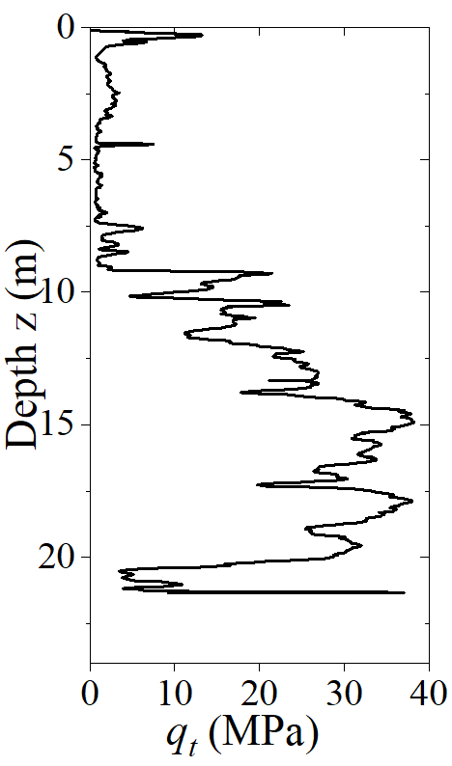
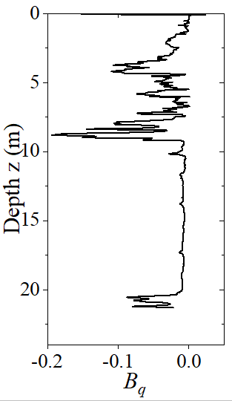
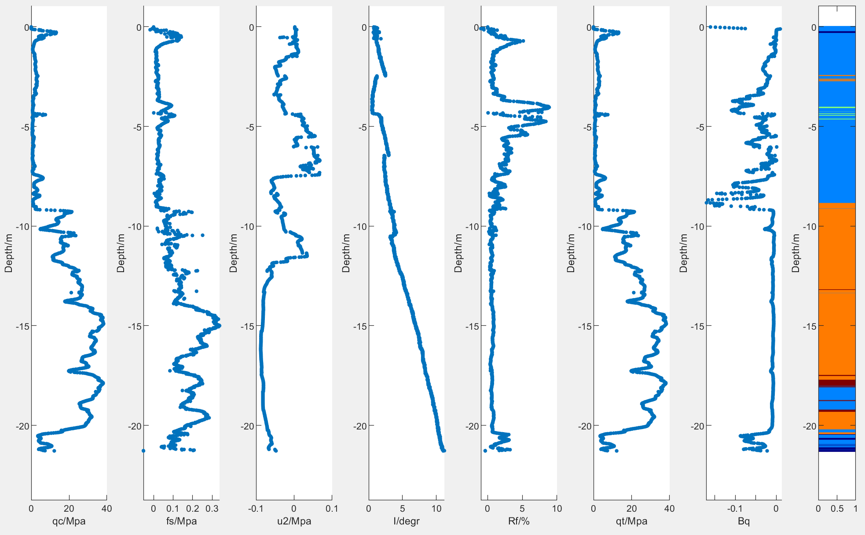
1. Background
3 ML-based soil types classification using CPT data
Origin data analysis
G
L
Pt
SC
SM
Output
Input
Using eight CPT characteristics to predict soil types
Notes:
The input of model is eight CPT characteristics; and the output is the predicted soil type.

Slide 10
1. Background
3 ML-based soil types classification using CPT data
Soil reclassification based on borehole data
Classification Criteria | Group Symbol | Group Name | New Group Symbol
Gravel> 50% of coarse fraction retained on No.4 (4.75 mm) sieve； Clean gravel <5% smaller than No.200 Sieve | GW | well-graded gravel, fine to coarse gravel | G
 | GP | poorly graded gravel
Gravel> 50% of coarse fraction retained on No.4 (4.75 mm) sieve；Gravel with >12% fines | GM | silty gravel
Silt and clay liquid limit < 50；Inorganic | ML | silt | L
Silt and clay liquid limit < 50；Organic | OL | organic silt, organic clay
Highly organic soils | Pt | peat | Pt
Sand ≥ 50% of coarse fraction passes No.4 (4.75 mm) sieve；Clean sand | SW | well-graded sand, fine to coarse sand | SC
 | SP | poorly graded sand
Sand ≥ 50% of coarse fraction passes No.4 (4.75 mm) sieve；Sand with >12% fines | SM | silty sand | SM
Soil reclassification based on soil property.
Notes:
Based on the soil property, we reclassify the soil types into 5 groups.

Slide 11
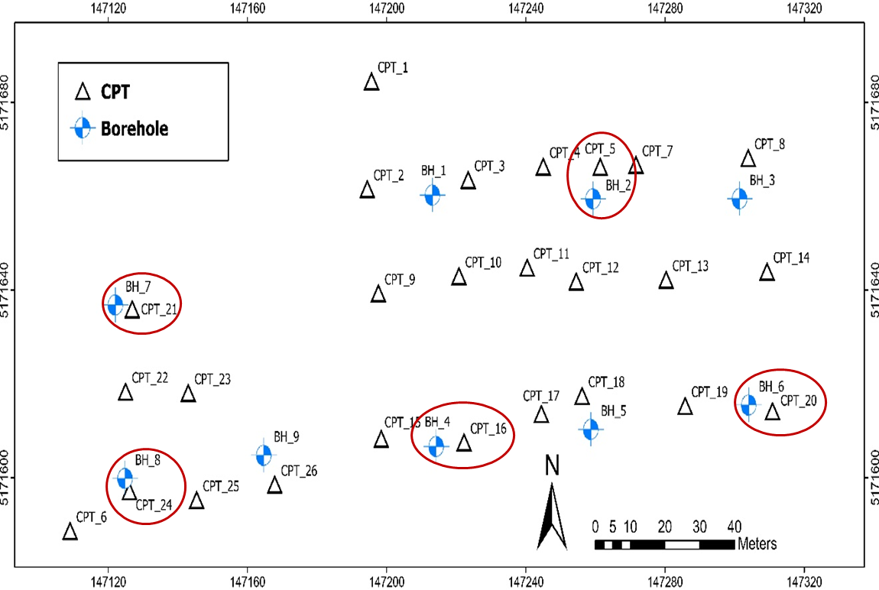
1. Background
3 ML-based soil types classification using CPT data
Interpret stratigraphic configuration based on Random Forest
Dataset Establishment
Model Training
Output types
G (GW, GP, GM)
L (ML, OL)
Pt
SC (SW, SP)
SM
Output types
Input features
Depth
Cone resistance
Sleeve friction
Dynamic pore pressure
Inclination
Friction ratio
Corrected cone resistance
Pore pressure ratio
Algorithm Selected: Random Forest
Hyperparameter Selection
Method: Grid SearchCV
Hyperparameters | Value
criterion | gini
n_estimators | 50
max_depth | 5
min_samples_split | 2
 | Data Size
Training | 5625
Validation | 1406
Dataset | 7031
Estimate the geological stratigraphic configuration of the closest 5 CPT soundings according to the 5 available boreholes to make training data.
Random Forest Model Training
Data Matching
Data Preprocessing
Dataset Dividion
Dataset Establishment
Performance on validation Set
Stratigraphic classification
Accuracy: 87.34%
Load the Model
Input 26 CPT soundings
Predict the stratigraphic configuration
Save the Model
Notes:
This slide presents the framework of the proposed random forest model.

Slide 12
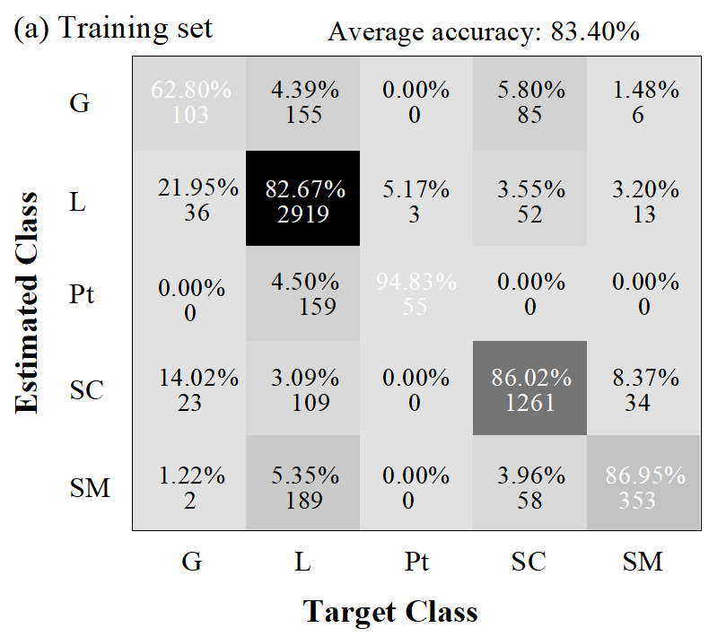
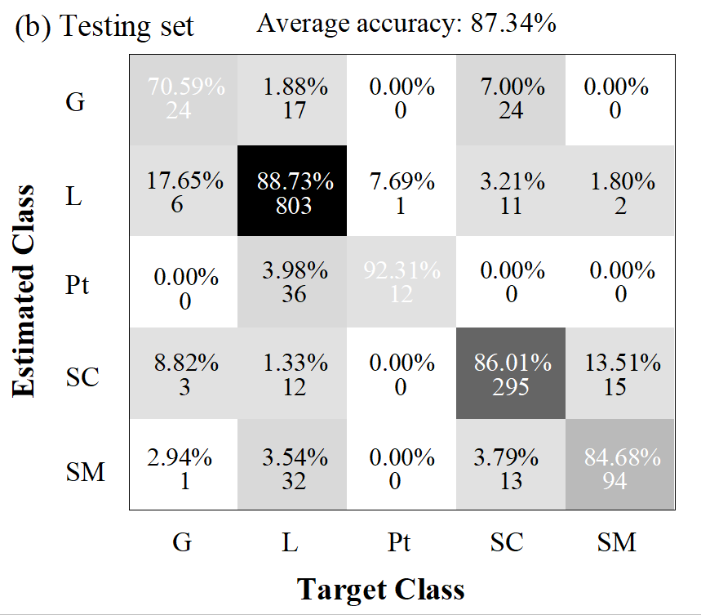
1. Background
3 ML-based soil types classification using CPT data
Performance of the optimal Random Forest model
Training set
Testing set
Average accuracy of Random Forest model in testing set is 87.34%.
Notes:
Finally, we get the Performance of the optimal Random Forest model.
The average accuracy is about 87%.

Slide 13
Content
1
Background
2
Problem statement and proposed framework
3
ML-based soil types classification using CPT data
4
Geologic uncertainty simulation using improved CMC
5
Uncertainty quantification of results
6
Conclusion
Notes:
Next,

Slide 14

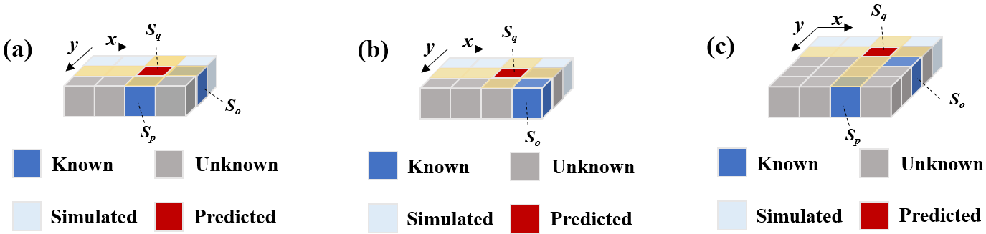
1. Background
4 Geologic uncertainty simulation using improved CMC model
Proposed improved 3D coupled Markov chain (CMC) model
Improved 3D CMC model
The advantages compared to traditional methods
More information from known units can be propagated to the predicted units.
If the known units and predicted units are not on the same axis, the results from the known units cannot influence the predicted units.
The benefits of the proposed 3D CMC model.
Notes:
We proposed an improved 3D coupled Markov chain model to simulate the soil stratification Based on limited borehole data.

Slide 15
1. Background
4 Geologic uncertainty simulation using improved CMC model
Estimating the transition probability matrix
Estimate the optimal transition probability matrix using (MSE) as the metric.
Horizontal transition probability matrix
The effect of number of simulations
The back analysis
The benefits of the proposed 3D CMC model.
Notes:
We use the (mean squared error) to obtain the optimal transition probability matrix.

Slide 16
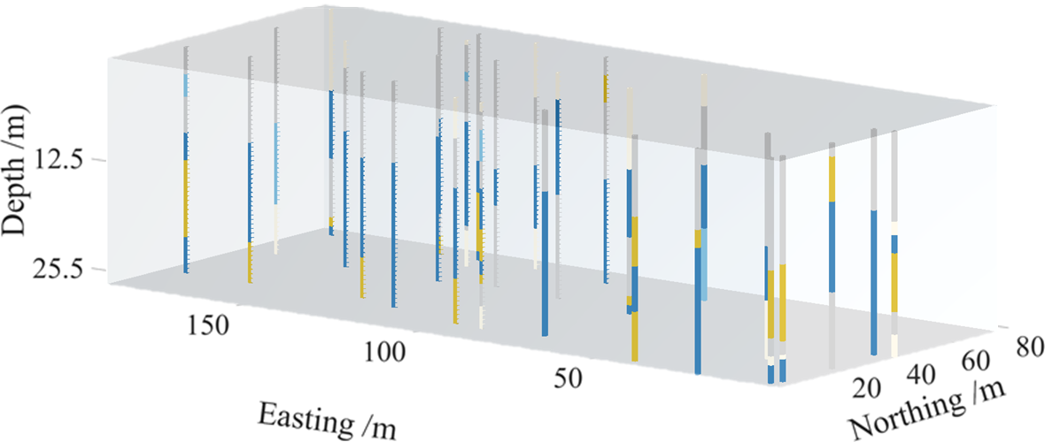
1. Background
4 Geologic uncertainty simulation using improved CMC model
Borehole and CPT data
G
L
Pt
SC
SM
The distribution of boreholes and CPT data.
Notes:
This slide shows the distribution of boreholes and CPT data. The CPT data is decoded into soil type information.

Slide 17
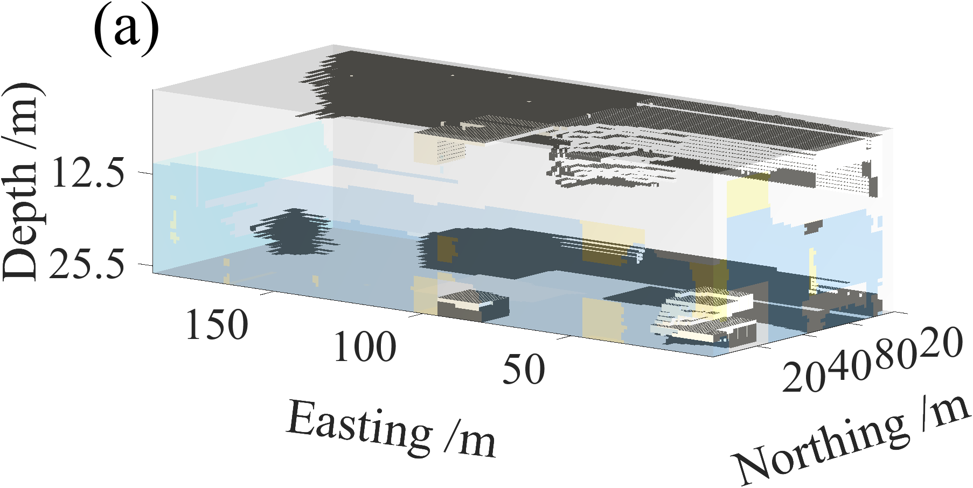
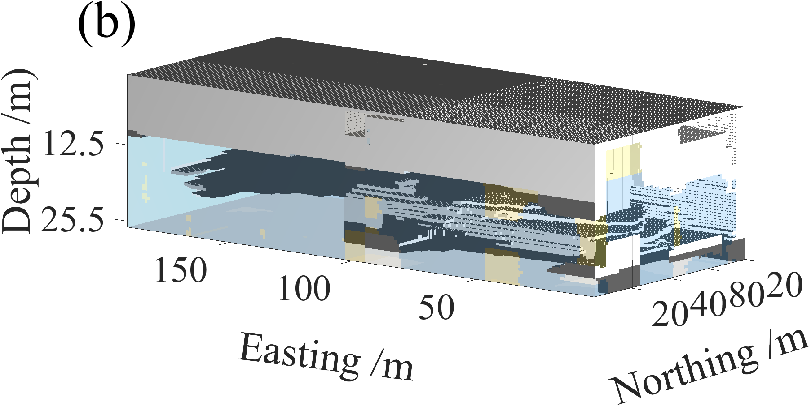
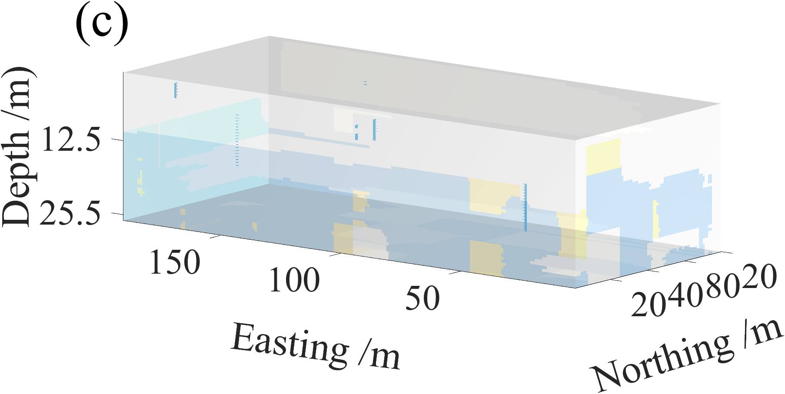
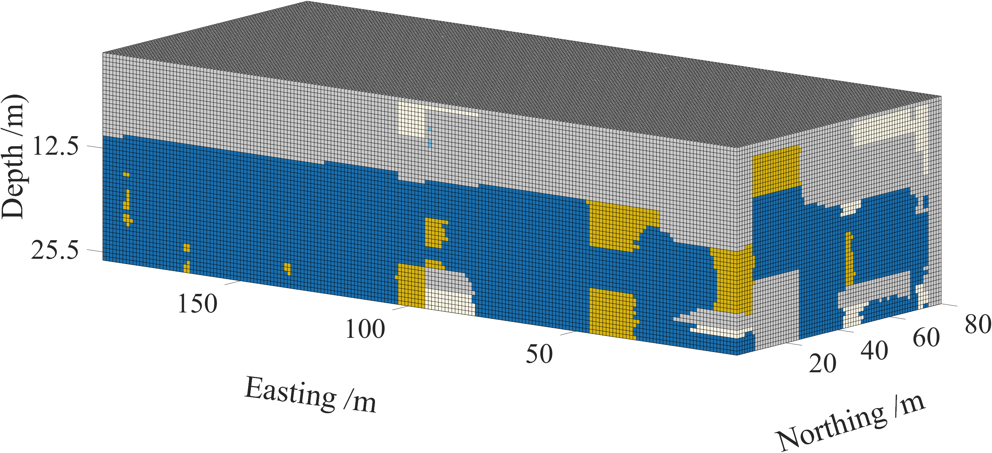
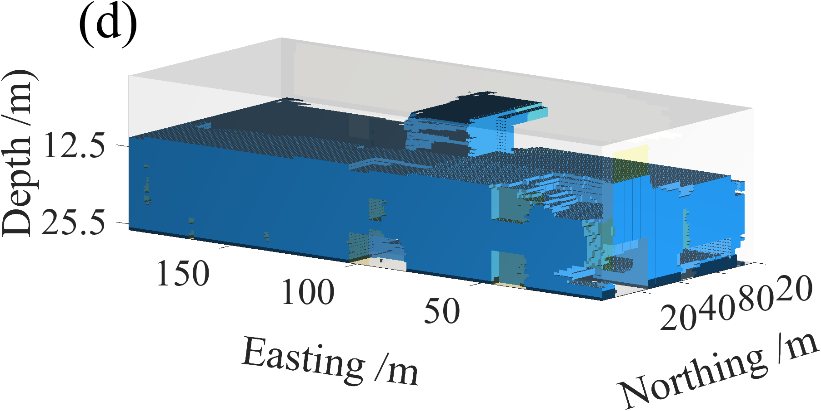
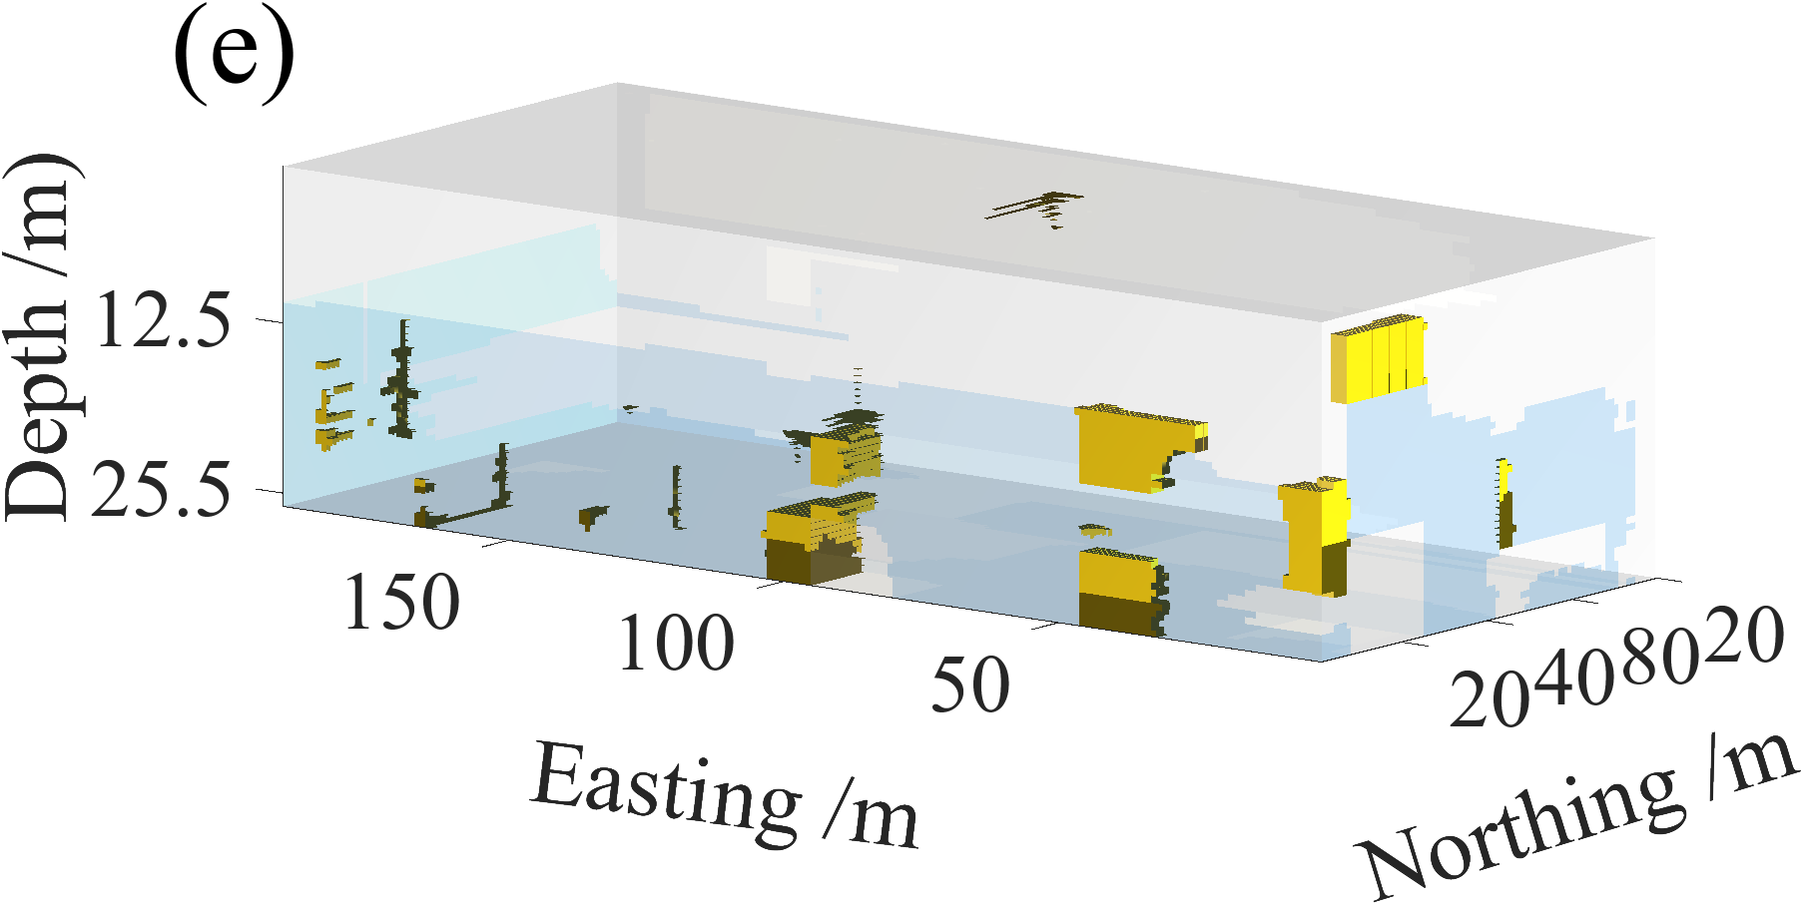
1. Background
4 Geologic uncertainty simulation using improved CMC model
Stratigraphic profiles using borehole and CPT
G
L
Pt
SC
SM
The simulated stratigraphic profiles using 3D CMC model.
Notes:
This is the simulated stratigraphic profiles. And the spatial distribution of each layer is also given.

Slide 18
Content
1
Background
2
Problem statement and proposed framework
3
ML-based soil types classification using CPT data
4
Geologic uncertainty simulation using improved CMC
5
Uncertainty quantification of results
6
Conclusion
Notes:
Meanwhile,

Slide 19
1. Background
5 Uncertainty quantification of results
Proposed uncertainty quantification index
(1) Matching rate index (MR)
MR is proposed to evaluate the accuracy of reserved testing boreholes.
(2) Information entropy (IE)
IE is adopted to measure the stratigraphic uncertainty.
The proposed uncertainty quantification index.
Notes:
Meanwhile, a Matching rate index MR value is proposed to evaluate the accuracy.

Slide 20
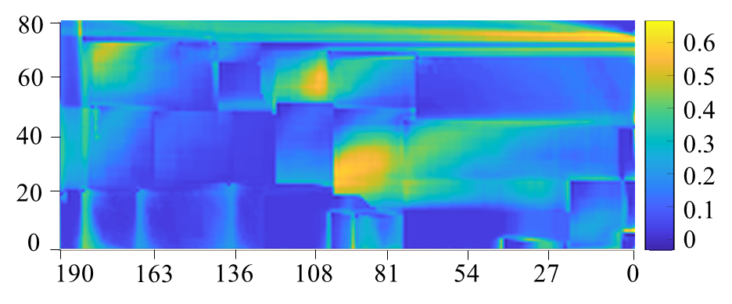
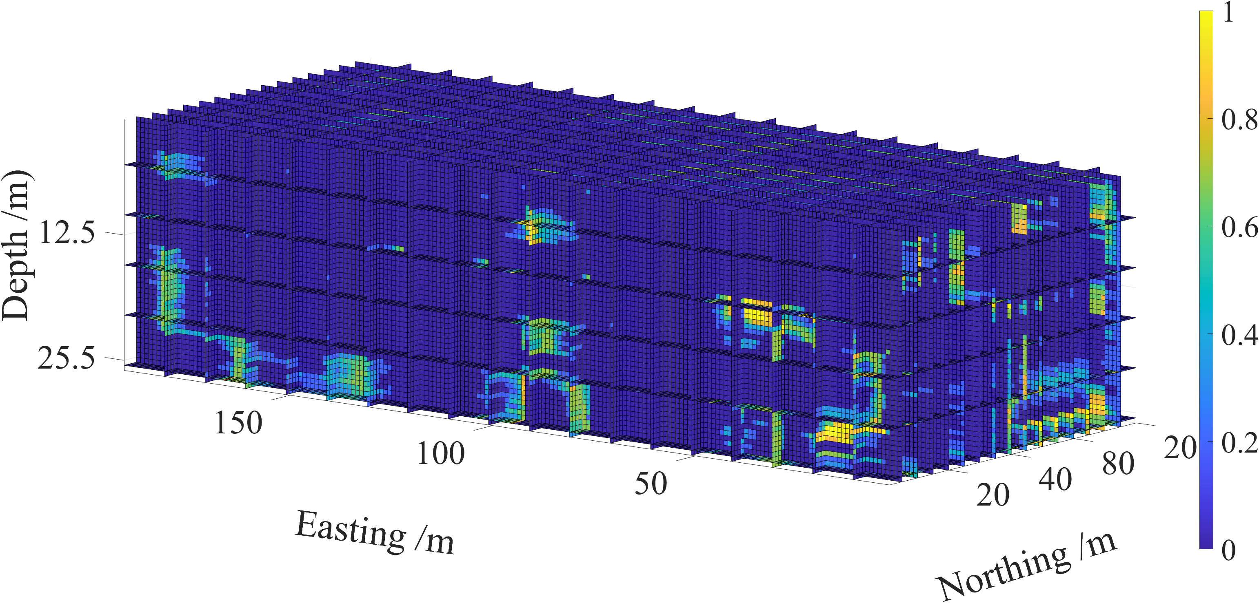
1. Background
5 Uncertainty quantification of results
Uncertainty quantification of results
Borehole | BH1 | BH3 | BH5 | BH9 | Mean
MR value | 83.72% | 54.90% | 78.43% | 70.59% | 71.91%
Total information entropy=0.1149
Northing /m
Easting /m
Top view
Information entropy
Uncertainty quantification of results using MR and IE.
Notes:
This slide shows the Uncertainty quantification of simulated results. The mean MR value is about 72%. And the total information entropy is about 0.1.

Slide 21
Content
1
Background
2
Problem statement and proposed framework
3
ML-based soil types classification using CPT data
4
Geologic uncertainty simulation using improved CMC
5
Uncertainty quantification of results
6
Conclusion
Notes:
Finally is the Conclusion.

Slide 22
4. 结论
6 Conclusion
Established a Random Forest model to classify the soil types using CPT data. The average accuracy of Random Forest model in testing set is 87.34%.
An improved 3D coupled Markov chain method based on limited boreholes was presented. A new method for estimating the 3D horizontal transition probability matrix was present.
Matching rate index was proposed to evaluate the accuracy of reserved testing boreholes. The average accuracy of the 4 testing boreholes is 71.91%.
Notes:
In this Competition, we established a Random Forest model to classify the soil types using CPT data. The average accuracy is about 87%.
Meanwhile, An improved 3D coupled Markov chain method was presented. A Matching rate index was proposed to evaluate the accuracy of reserved testing boreholes.

Slide 23


岩石力学中的不确定性问题及机器学习策略
Thanks for your attention!

